Slide 1


Neural Models for Information Retrieval
Bhaskar Mitra
Principal Applied Scientist
Microsoft
Research Student
Dept. of Computer Science
University College London

Slide 2
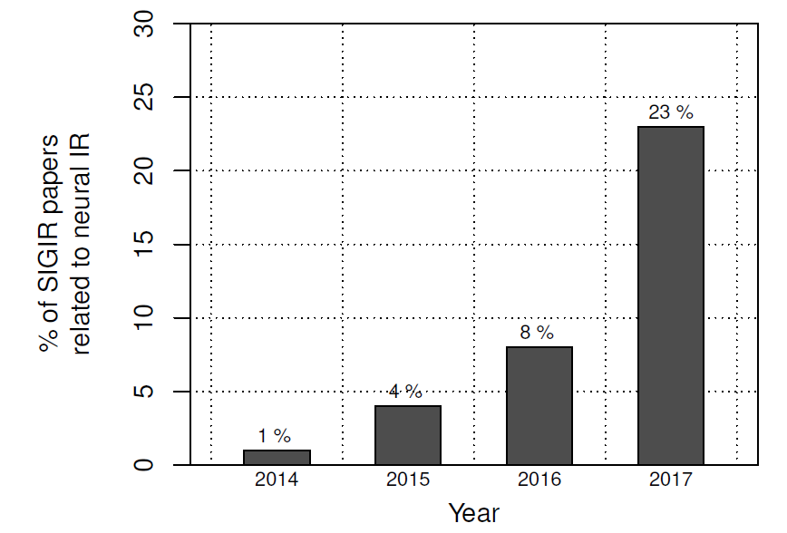
Neural Networks
Amazingly successful on many difficult application areas
Dominating multiple fields:
Each application is different, motivates new innovations in machine learning
2011 | 2013 | 2015 | 2017
speech | vision | NLP | IR?
Our research:
Novel representation learning methods and neural architectures motivated by specific needs and challenges of IR tasks

Slide 3


Today’s topics
Information Retrieval (IR) tasks
Representation learning for IR
Topic specific representations
Dealing with rare concepts/terms

Slide 4
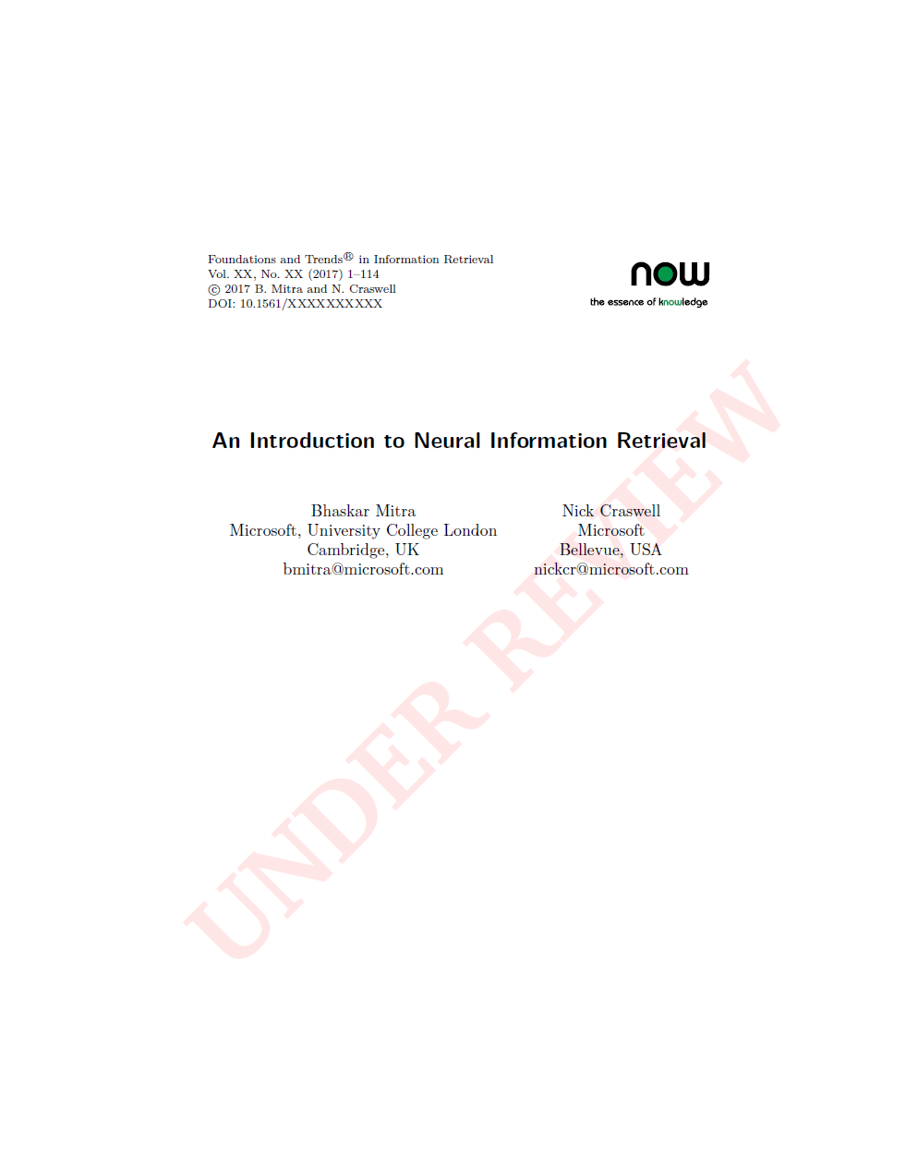
This talk is based on work done in collaboration with
Nick Craswell, Fernando Diaz, Emine Yilmaz, Rich Caruana, and Eric Nalisnick
Some of the content is from the manuscript under review for
Foundations and Trends® in Information Retrieval
Pre-print is available for free download
http://bit.ly/neuralir-intro
Final manuscript may contain additional content and changes

Slide 5
IR tasks

Slide 6



Document ranking
Information need
query
Relevance
(documents satisfy information need e.g. useful)
retrieval system indexes a document corpus
results ranking (document list)

Slide 7
Other IR tasks
Query Formulation
Next Query suggestion
cheap flights from london t|
cheap flights from london to miami
cheap flights from london to frankfurt
cheap flights from london to new york
cheap flights from london to miami
cheap flights from london to sydney
Related searches
package deals to miami
ba flights to miami
things to do in miami
miami tourist attractions

Slide 8
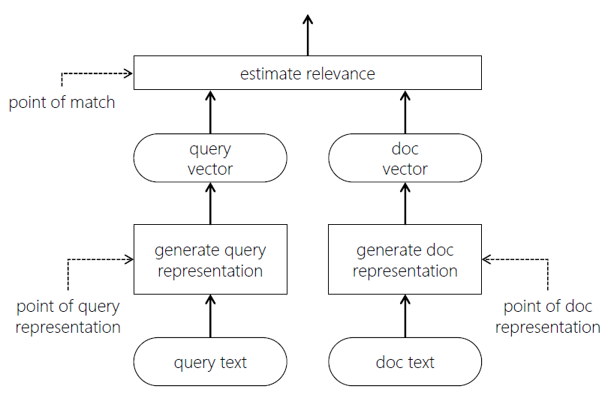
Anatomy of an IR model
IR in three simple steps:
Generate input (query or prefix) representation
Generate candidate (document or suffix or query) representation
Estimate relevance based on input and candidate representations
Neural networks can be useful for one or more of these steps

Slide 9
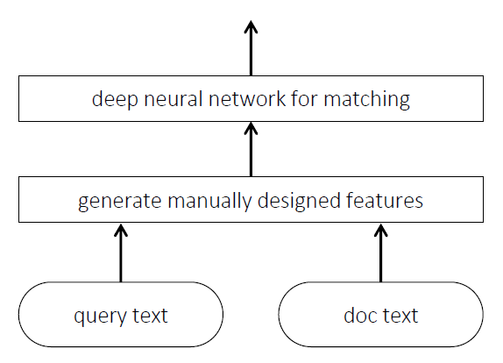
Example: Classical Learning to rank (LTR) models
Query and document representation based on manually crafted features
Neural network for matching

Slide 10
Representation learning for IR

Slide 11
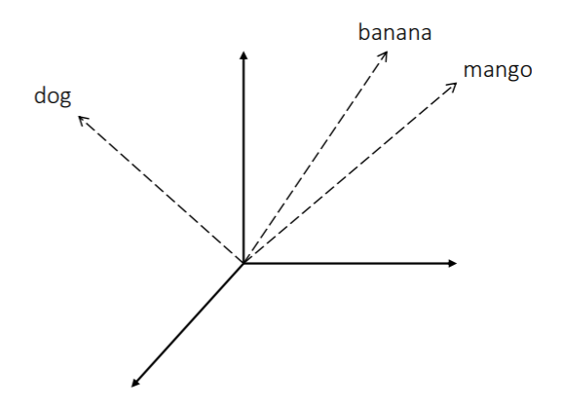
A quick refresher on vector Space representations
Represent items by feature vectors – similar items have similar vector representations
Corollary: the choice of features define what items are similar
An embedding is a new space such that the properties of, and the relationships between, the items are preserved
Compared to original feature space an embedding space may have one or more of the following:
Less number of dimensions
Less sparseness
Disentangled principle components

Slide 12
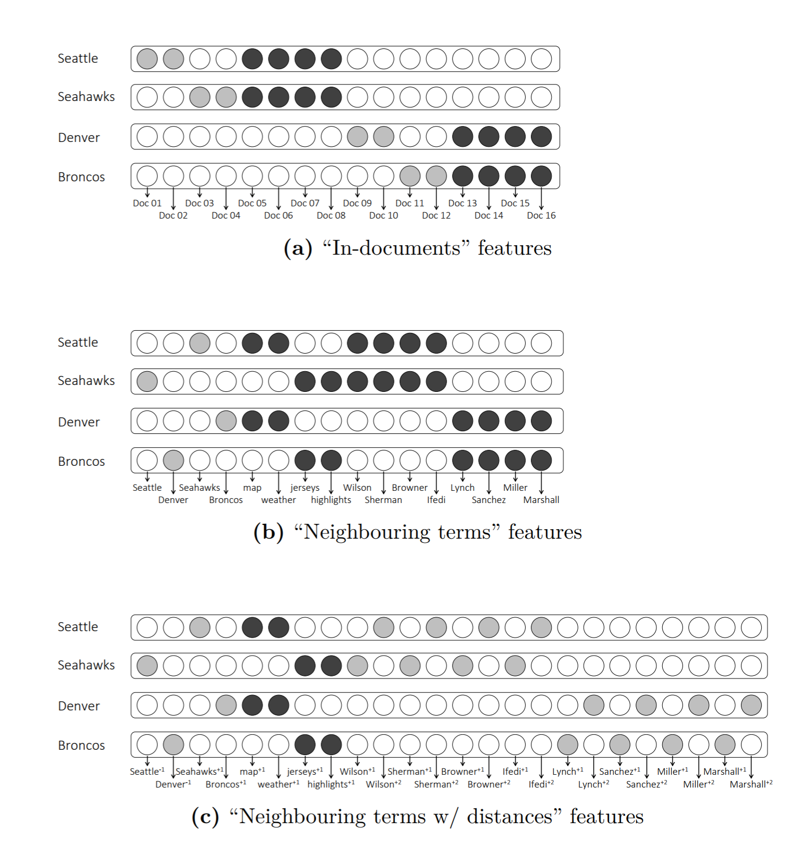
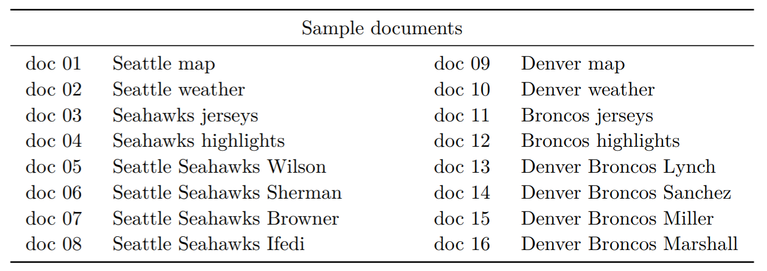
Notions of similarity
Is “Seattle” more similar to…
“Sydney” (similar type)
Or
“Seahawks” (similar topic)
Depends on what feature space you choose

Slide 13
Desired notion of similarity should depend on the target task
Document ranking
Query formulation
Next query suggestion
cheap flights to london
cheap flights to |
cheap flights to london
✓ budget flights to london
✗ cheap flights to sydney
✗ hotels in london
✓ cheap flights to london
✓ cheap flights to sydney
✗ cheap flights to big ben
✓ budget flights to london
✓ hotels in london
✗ cheap flights to sydney
Next, we take a sample model and show how the same model captures different notions of similarity based on the data it is trained on

Slide 14
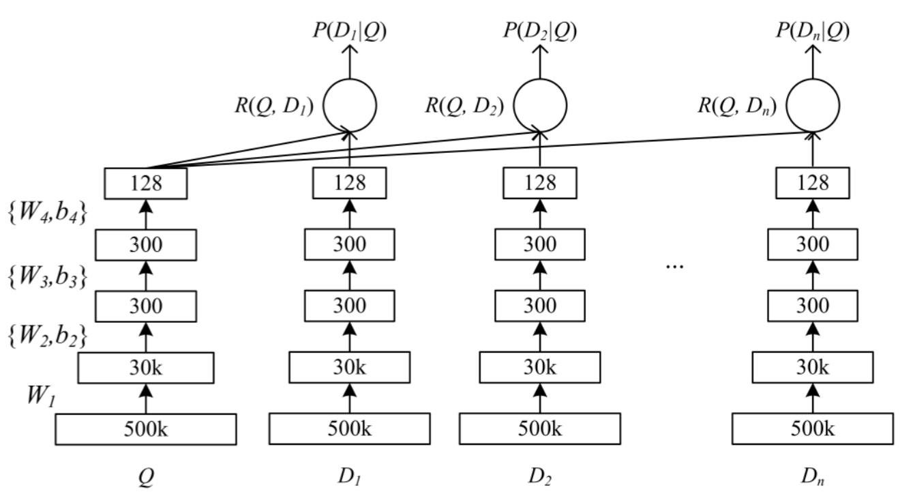
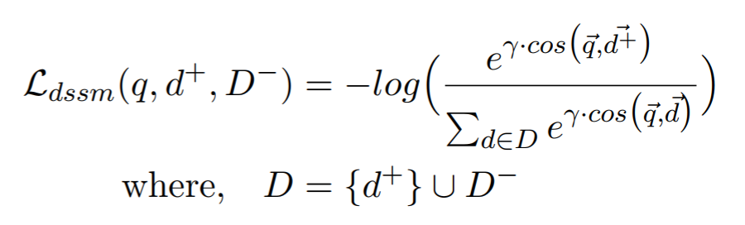
Deep semantic similarity model (dssm)
Siamese network with two deep sub-models
Projects input and candidate texts into embedding space
Trained by maximizing cosine similarity between correct input-output pairs

Slide 15
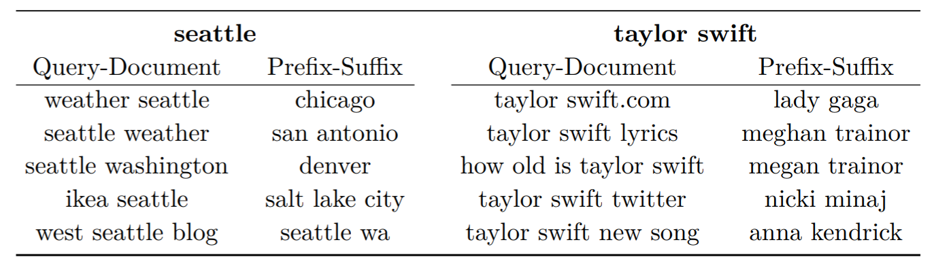
Same model (DSSM), different training data
DSSM trained on query-document pairs
DSSM trained on query prefix-suffix pairs
(Shen et al., 2014)
https://dl.acm.org/citation...
(Mitra and Craswell, 2015)
https://dl.acm.org/citation...
Nearest neighbors for “seattle” and “taylor swift” based on two DSSM models trained on different types training data

Slide 16
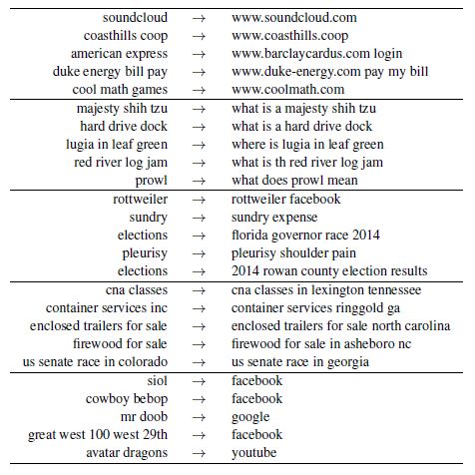
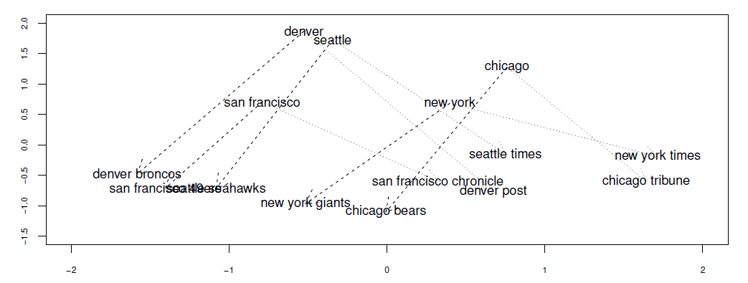
Same DSSM, trained on Session query pairs
Can capture regularities in the query space (similar to word2vec for terms)
Groups of similar search intent transitions from a query log
(Mitra, 2015)
https://dl.acm.org/citation...

Slide 17
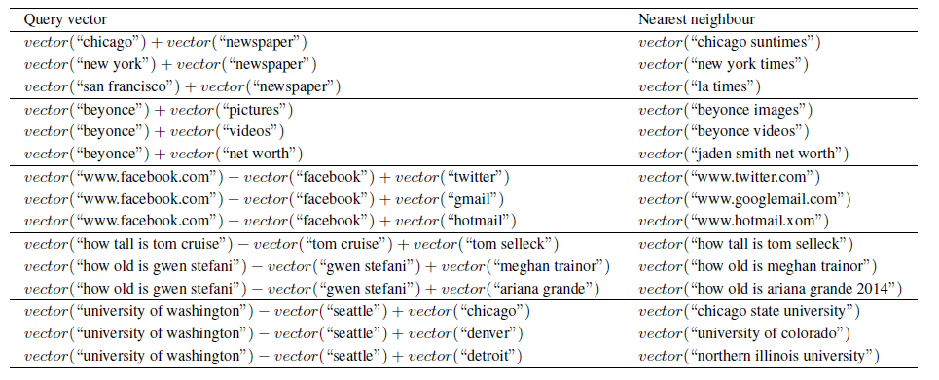
Same DSSM, trained on Session query pairs
Allows for analogy-like vector algebra over short text!

Slide 18
When is it particularly important to think about notions of similarity?
If you are using pre-trained embeddings, instead of learning them in an end-to-end model for the target task because not enough training data is available for fully supervised learning of representations

Slide 19
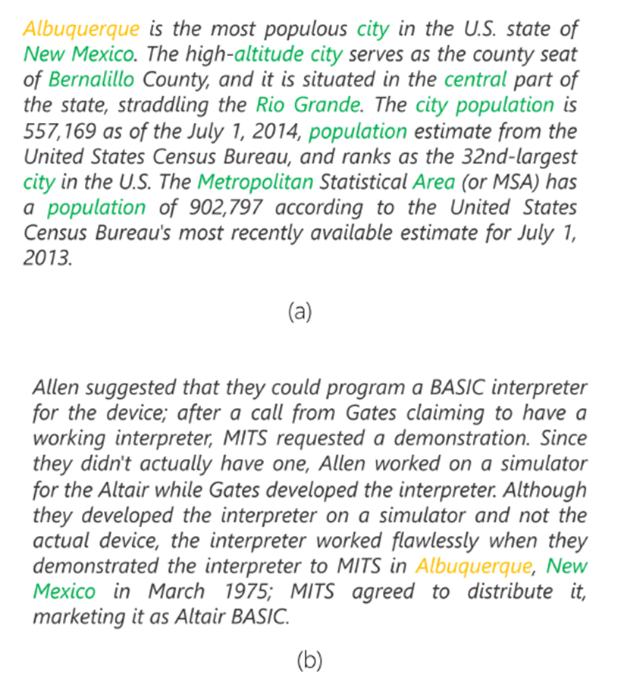
Using pre-trained word embeddings for document ranking
Traditional IR models count number of query term matches in document
Non-matching terms contain important evidence of relevance
We can leverage term embeddings to recognize that document terms “population” and “area” indicates relevance of document to the query “Albuquerque”
Passage about Albuquerque
Passage not about Albuquerque

Slide 20
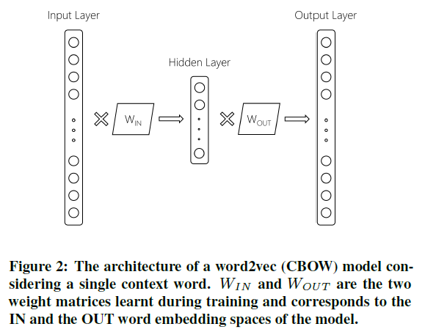
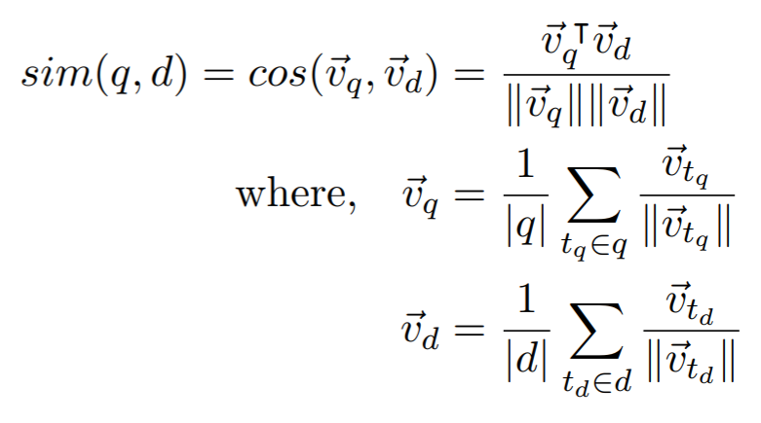
using word2vec for soft-matching
Compare every query and document term in the embedding space
What if I told you that everyone using word2vec is throwing half the model away?

Slide 21
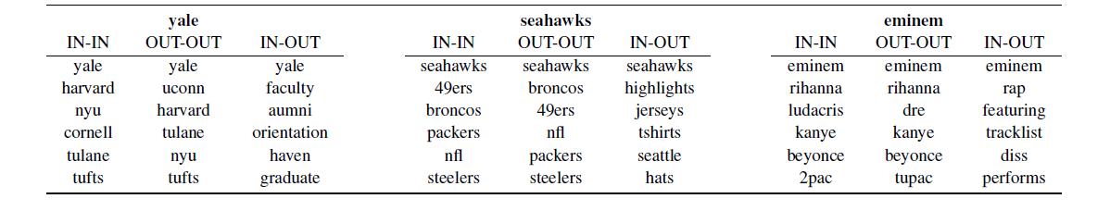
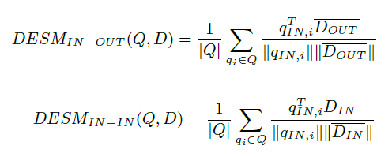
Dual embedding space model (DESM)
IN-OUT similarity captures a more Topical notion of term-term relationship compared to IN-IN and OUT-OUT
Better to represent query terms using IN embeddings and document terms using OUT embeddings
(Mitra et al., 2016)
https://arxiv.org/abs/1602.01137

Slide 22
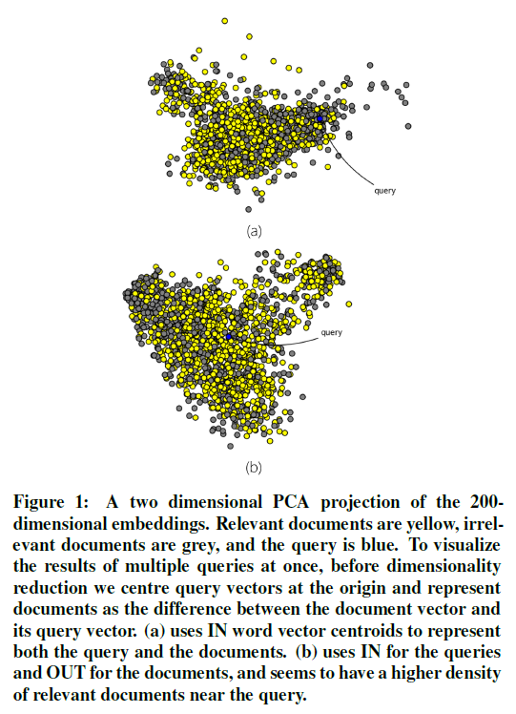
IN-OUT vs. IN-IN

Slide 23
Get the data
Download
IN+OUT Embeddings for 2.7M words trained on 600M+ Bing queries
https://www.microsoft.com/en-us/download/details.aspx?id=52597

Slide 24
Topic specific representations

Slide 25
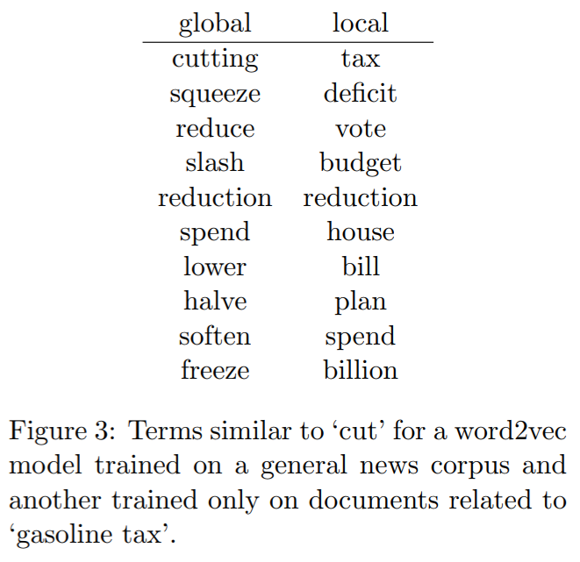
Why is topic-specific term representation useful?
Terms can take different meanings in different context – global representations likely to be coarse and inappropriate under certain topics
Global model likely to focus more on learning accurate representations of popular terms
Often impractical to train on full corpus – without topic specific sampling important training instances may be ignored

Slide 26
Topic-specific term embeddings for query expansion
query
corpus
cut gasoline tax
results
Use documents from first round of retrieval to learn a query-specific embedding space
Use learnt embeddings to find related terms for query expansion for second round of retrieval
topic-specific term embeddings
cut gasoline tax deficit budget
(Diaz et al., 2015)
http://anthology.aclweb.org/...
expanded query
final results

Slide 27
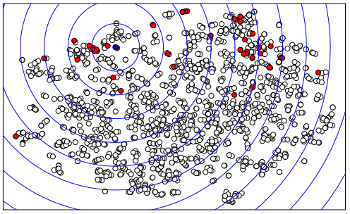
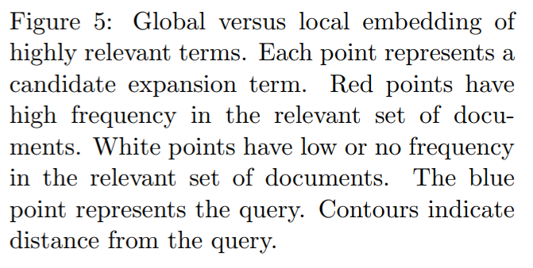
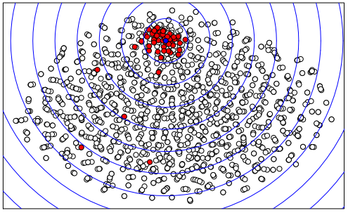
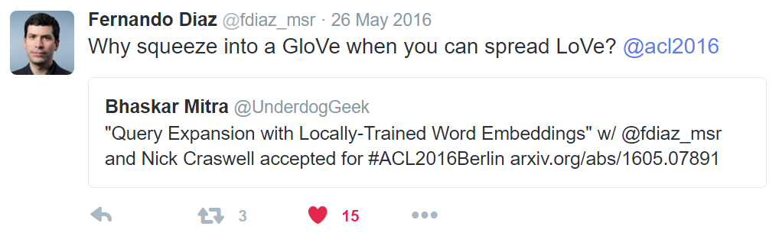
global
local

Slide 28
The idea of learning (or updating) representations at runtime may be applicable in the context of AI approaches to solving other more complex tasks
For IR, in practice…
We can pre-train k (≈ millions of) different embedding spaces and pick the most appropriate representation at runtime without re-training

Slide 29
Dealing with rare concepts and terms

Slide 30
A tale of two queries
Query: “pekarovic land company”
Query: “what channel seahawks on today”
Hard to learn good representation for rare term pekarovic
But easy to estimate relevance based on patterns of exact matches
Proposal: Learn a neural model to estimate relevance from patterns of exact matches
Target document likely contains ESPN or sky sports instead of channel
An embedding model can associate ESPN in document to channel in query
Proposal: Learn embeddings of text and match query with document in the embedding space

Slide 31
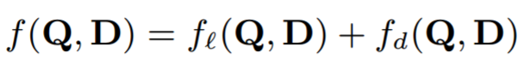
The Duet architecture
Sum
Linear combination of two models trained jointly on labelled query-document pairs
Local model operates on lexical interaction matrix, while Distributed model projects text into embedding space and estimates match
Fully connected layers for matching
Fully connected layers for matching
Generate interaction matrix
Hadamard product
Query
term vector
Doc
term vector
Query
embedding
Doc
embedding
Generate query term vector
Generate doc term vector
Generate query embedding
Generate doc embedding
(Mitra et al., 2017)
https://dl.acm.org/citation...
(Nanni et al., 2017)
https://dl.acm.org/citation...
Query text
Doc text
Query text
Doc text
Local model
Distributed model

Slide 32
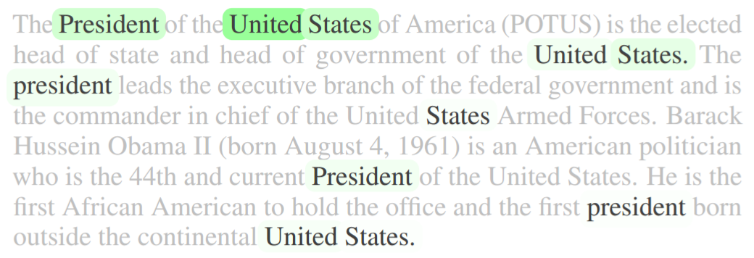
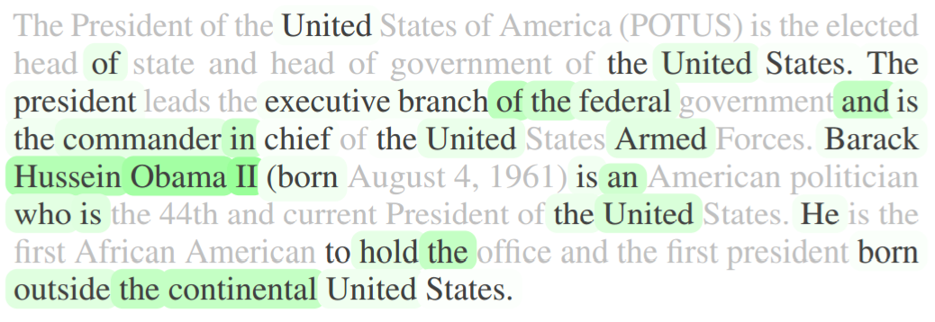
Term importance
Local model
Distributed model
Query: united states president

Slide 33
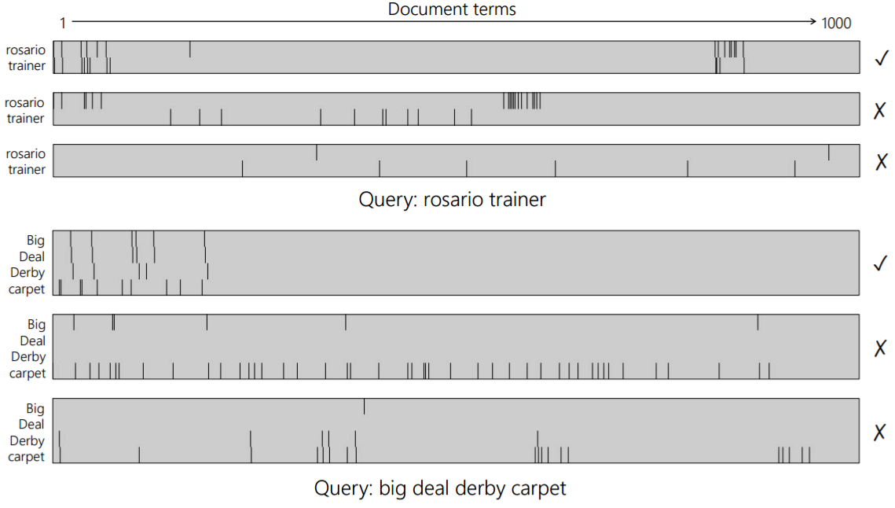
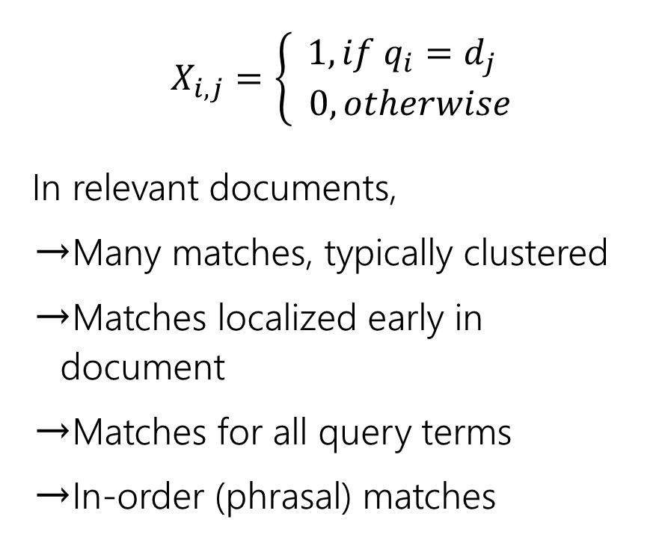
Local model: term interaction matrix
$$X_{i,j}=\left\{\begin{aligned}1, if q_{i}=d_{j} \\ 0, otherwise\end{aligned}\right.$$
In relevant documents,
Many matches, typically clustered
Matches localized early in document
Matches for all query terms
In-order (phrasal) matches

Slide 34

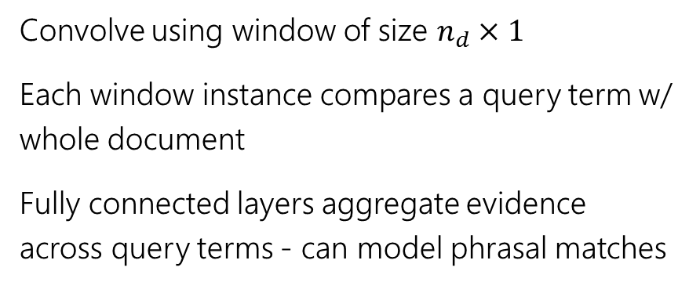
Local model: estimating relevance
Convolve using window of size $n_{d}×1$
Each window instance compares a query term w/ whole document
Fully connected layers aggregate evidence across query terms - can model phrasal matches
← query words →
← document words →

Slide 35
Distributed model: estimating relevance
Convolve over query and document terms
Match query with moving windows over document
Learn text embeddings specifically for the task
Matching happens in embedding space
* Network architecture slightly simplified for visualization – refer paper for exact details
Fully connected
…
Hadamard product
Query embedding
Hadamard product
…
pooling
convolution
…
query
document

Slide 36
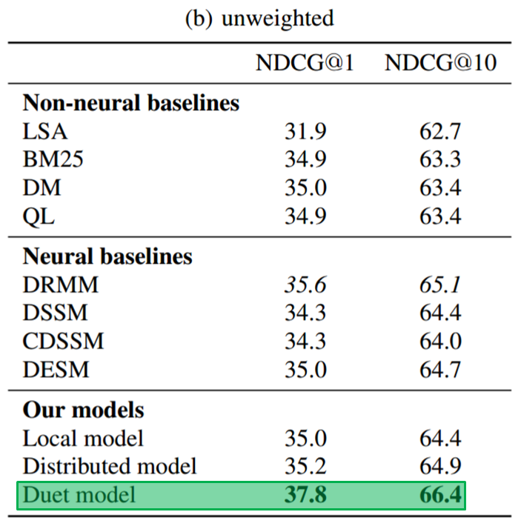
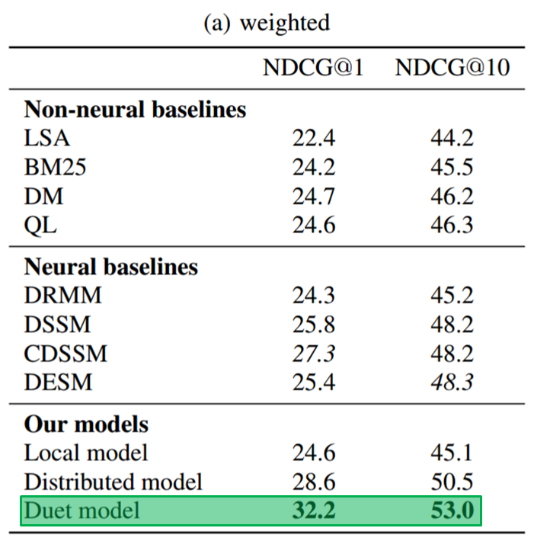
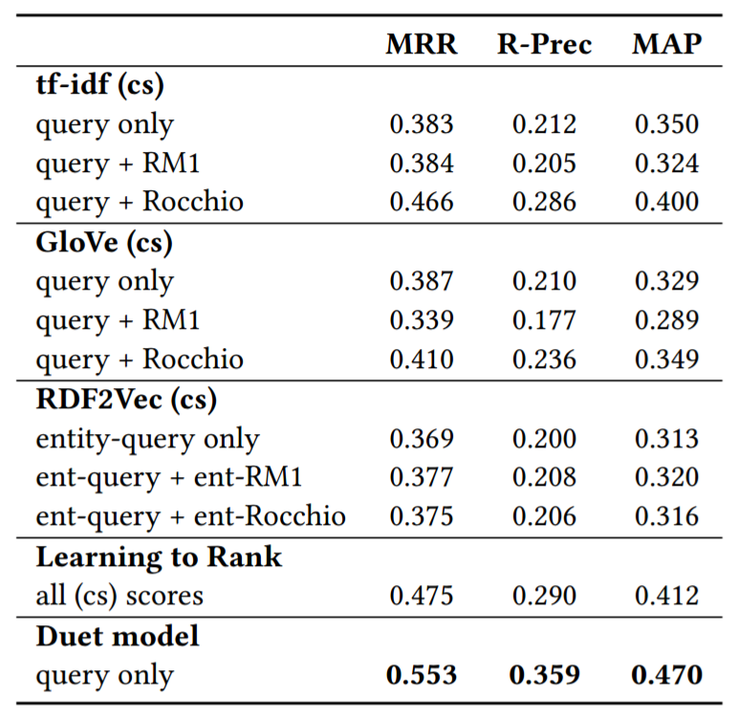
Strong performance on document and answer ranking tasks

Slide 37
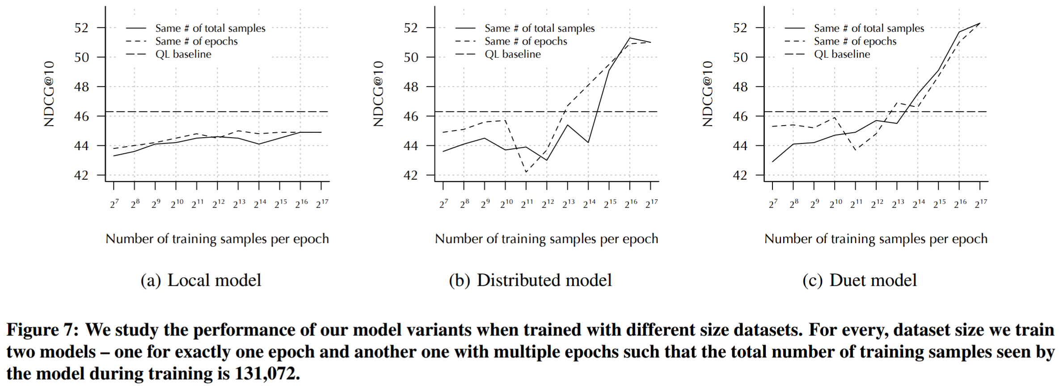
Effect of training data volume
Key finding: large quantity of training data necessary for learning good representations, less impactful for training local model

Slide 38
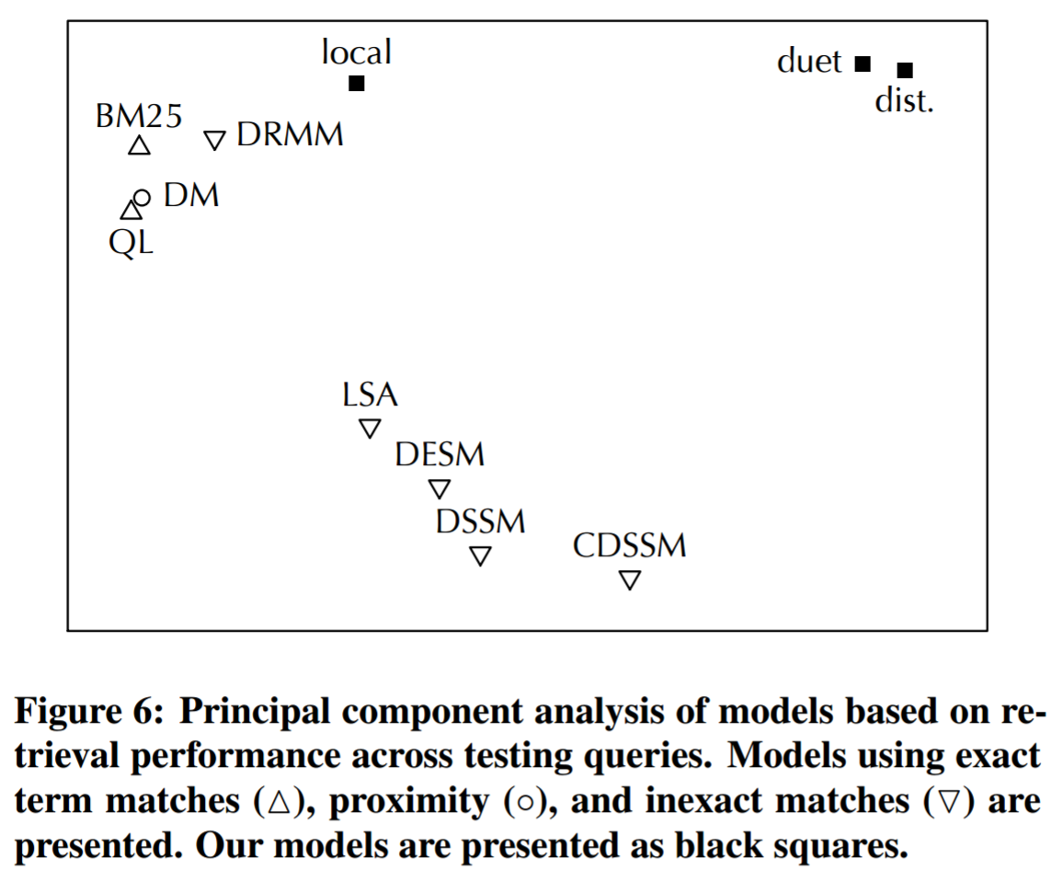
If we classify models by query level performance there is a clear clustering of lexical (local) and semantic (distributed) models

Slide 39
Get the code
Download
Implemented using CNTK python API
https://github.com/bmitra-msft/NDRM/blob/master/notebooks/Duet.ipynb

Slide 40
Summary

Slide 41
Recap
When using pre-trained embeddings consider whether the relationship between items in the embedding space is appropriate for the target task
If a representation can be learnt (or updated) based on the current input / context it is likely to outperform a global representation
It is difficult to learn good representations for rare items, but important to incorporate them in the modeling
While these insights are grounded in IR tasks, they should be generally applicable to other NLP and machine learning scenarios

Slide 42
List of papers discussed
An Introduction to Neural Information Retrieval
Bhaskar Mitra and Nick Craswell, in Foundations and Trends® in Information Retrieval, Now Publishers, 2017 (upcoming).
https://www.microsoft.com/en-us/research/publication/...
Learning to Match Using Local and Distributed Representations of Text for Web Search
Bhaskar Mitra, Fernando Diaz, and Nick Craswell, in Proc. WWW, 2017.
https://dl.acm.org/citation.cfm?id=3052579
Benchmark for Complex Answer Retrieval
Federico Nanni, Bhaskar Mitra, Matt Magnusson, and Laura Dietz, in Proc. ICTIR, 2017.
https://dl.acm.org/citation.cfm?id=3121099
Query Expansion with Locally-Trained Word Embeddings
Fernando Diaz, Bhaskar Mitra, and Nick Craswell, in Proc. ACL, 2016
http://anthology.aclweb.org/P/P16/P16-1035.pdf
A Dual Embedding Space Model for Document Ranking
Bhaskar Mitra, Eric Nalisnick, Nick Craswell, and Rich Caruana, arXiv preprint, 2016
https://arxiv.org/abs/1602.01137
Improving Document Ranking with Dual Word Embeddings
Eric Nalisnick, Bhaskar Mitra, Nick Craswell, and Rich Caruana, in Proc. WWW, 2016
https://dl.acm.org/citation.cfm?id=2889361
Query Auto-Completion for Rare Prefixes
Bhaskar Mitra and Nick Craswell, in Proc. CIKM, 2015
https://dl.acm.org/citation.cfm?id=2806599
Exploring Session Context using Distributed Representations of Queries and Reformulations
Bhaskar Mitra, in Proc. SIGIR, 2015
https://dl.acm.org/citation.cfm?id=2766462.2767702

Slide 43
Thank You

